Slide 1
Database Design: Class 3

Slide 2
What We’ll Cover Today …
In this class, we will …
  “Strong” and “weak” entities
  “Intersection” entities
  “Subordinate” entities (specialisation / generalisation)
  Normalisation
© Michael Lang, National University of Ireland, Galway

Slide 3

Strong and Weak Entities
An instance of a Strong Entity can exist independently
An instance of a Weak Entity can only exist if there is a related instance of some other entity
Example: A Degree may be taken by zero or more Students; A Student must register for a Degree
DEGREE
STUDENT
cao_code
student ID
degree_title
taken by
student_name
annual_fee
register for
address
date_of_birth

Slide 4
Intersection Entities
A decomposition of a single Many-to-Many relationship into multiple One-to-Many / Many-to-One relationships
At the very least, its attributes will consist of the combination of the identifiers of the entities which participated in the Many-to-Many relationship
It can have additional attributes of its own
Naming intersection entities
  Base name of intersection entity on the relationship
  Concatenate entity names if there is no obvious name
Example: Railway Company - A train stops at many stations; a station is serviced by many trains …

Slide 5
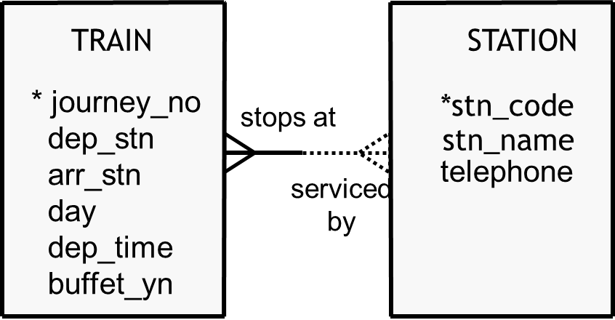
Intersection Entities
For example, a train leaves Galway at 7:30AM every Monday with final destination Dublin
We need to know what stations it stops at …
… but we also need to know what time it departs each station, and from what platform (attributes of the relationship)

Slide 6
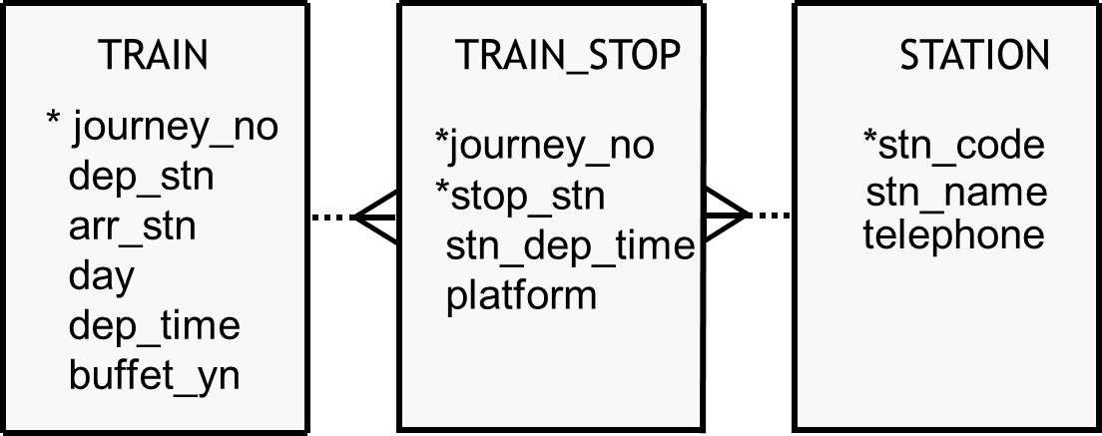
Intersection Entities
The solution is to create an intersection entity
In this example, dep_stn, arr_stn, and stop_stn are all foreign keys linked to stn_code

Slide 7
Subordinate Entities
Consider the following example:
  There are 800 employees in an organisation, 600 of which receive hourly wages, and 200 of which receive salaries
  Of the 200 salaried employees, 50 are field service engineers
  The RSI Number, Taxation Bracket, Name, Address, Telephone Extension, Email Address, Department, and Job Title of all employees is recorded in a database
  Additionally, for waged employees, the Hourly Wage and Hours Worked is recorded
  For salaried employees, the Weekly Salary is recorded
  For the field service engineers, Company Car Registration Number and Mobile Phone are recorded
How should this be modeled ? ...

Slide 8
Subordinate Entities
EMPLOYEE
*RSI_Number
Taxation_Bracket
Name
Address
Telephone_Ext
Email
Dept
Job_Title
Hourly_Rate
Hrs_Worked
Weekly_Salary
Car_Reg_Num
Mobile_Phone_Num
Possibility 1:
  Model it as a single entity
  Problem: this is inefficient, wasteful, and confusing

Slide 9
Subordinate Entities
EMPLOYEE
*RSI_Number
Taxation_Bracket
Name
Address
Telephone_Ext
Email
Dept
Job_Title
WAGED_EMP
Hourly_Rate
Hrs_Worked
SALARIED_EMP
Weekly_Salary
FIELD_SVC_ENG
Car_Reg_Num
Mobile_Phone_Num
Possibility 2:
  Model it using subordinate entities
  Logically, this is the same as Possibility 3 (the physical implementation)

Slide 10
Subordinate Entities
EMPLOYEE
*RSI_Number
Taxation_Bracket
Name
Address
Telephone_Ext
Email
Dept
Job_Title
WAGED_EMP
*RSI_Number
Hourly_Rate
Hrs_Worked
SALARIED_EMP
*RSI_Number
Weekly_Salary
Possibility 3:
  Use One-to-One relationships
  may be exclusive “either-or” relationships (note arc)
  may be mandatory-to-mandatory or optional-to-mandatory
FIELD_SVC_ENG
*RSI_Number
Car_Reg_Num
Mobile_Phone_Num

Slide 11
What is a “Good” Data Model ?
Basic construction rules should be obeyed
There should be no ambiguity:
  All entities, attributes, relationships, and identifiers are defined and labeled
  Names are meaningful to the client and to the developer
  Beware of homonyms(same word/different meanings) and synonyms (different words/same meaning)
The model should be faithful to reality:
  Accurately describes the world it is supposed to represent
  Relationships are of the correct degree (cardinality)
  Data model is complete, understandable, precise, and at the right level of detail ?

Slide 12
What is a “Good” Data Model ?
The model should be as simple as possible
There should be no redundant or duplicated data
The model should be flexible and adaptable to future needs
Have all exceptions been considered ?
Notes:
407-408

Slide 13
Normalisation
Normalisation is a technique for simplifying the design of a relational database so that it achieves the optimum structure with minimal redundancy
The normal forms are a linear progression of rules applied to database design, with each higher normal form achieving a better, more efficient design
The normal forms are:
  Un-normalised
  First Normal Form (1NF)
  Second Normal Form (2NF)
  Third Normal Form (3NF)
  Boyce-Codd Normal Form (BCNF)
  Fourth Normal Form (4NF)
  Fifth Normal Form (5NF)
Notes:
408

Slide 14
Relationships of Attributes
one-to-one
  a value of an attribute determines the value of another attribute and vice versa; that is, A → B and B → Α
  for example:
    IRL → Republic of Ireland, Republic of Ireland → IRL
  Only occurs when both attributes are unique
one-to-many
  a value of one attribute determines the value of another attribute but not vice versa; that is, A → B but not B → Α
  for example:
    Republic of Ireland → € Euro
    € Euro → ??? (could be France ? Germany ? Spain ? Rep. of Ireland etc..)

Slide 15
Relationships of Attributes
many-to-many
  neither attribute determines the other
  A not → B
  B not → A
  for example:
    country name not → language (in Ireland, official languages are Irish and English)
    language not → country name (English is an official language of Ireland, United Kingdom, New Zealand, etc.)

Slide 16
Functional Dependencies
A functional dependency is a relationship between attributes in a relation, whereby an attribute (or combination of attributes) determine the value of another attribute
Attribute B is said to be functionally dependent on attribute A if, for every unique value of A in the database, there exists no more than one correlated value of B
Otherwise put, attribute A is said to be the determinant of attribute B, A → B
If the determinant is a single-attribute, those attributes which depend on it are said to be fully_x0015_functionally dependent
If the determinant is a combination of attributes (for example, a composite identifier), an attribute is not fully functionally dependent upon it only a part of the combination is required to determine it. This is also called a partial dependency

Slide 17
First Normal Form (1NF)
For a relation (table) to be in 1NF, it must satisfy the following conditions:
  All rows must have the same number of columns
  All values are atomic; otherwise put, there are no multi-valued attributes / “repeating groups” (at most one value for each row-column intersection)
  There can be no duplicate rows; that is, every row must have a unique primary key (identifier)
  Every non-key attribute must be functionally dependent upon the primary key
  The rows and columns are not necessarily in any particular order

Slide 18
Multi-valued Attributes
How are multi-valued attributes / repeating groups resolved ?
Consider a Student’s Exam Result Sheet with following structure:
    Student ID
    + Student_Name
    + Student_Address
    + {Module_Code + Module_Description + Mark}
    + Average
    + Grade
Transform to 1NF by placing repeating groups into new relation:
    STUDENT = Student ID + Student_Name + Student_Address
    + Average + Grade;
    EXAM_RESULT = Student ID + Module_Code
    + Module_Description + Mark;

Slide 19
1NF: Anomalies
1NF is inefficient as it can give rise to a variety of possible anomalies
Insertion Anomaly:
  bear in mind the rule of “entity integrity”: it is not allowable for any part of the primary key of a record to be null
  in the case of composite identifiers, it is insufficient to have a value in one of the component columns but no value in the other(s)
  insertion anomalies arise whereby data cannot be inserted because a complete primary key is not available
Deletion Anomaly:
  this is the inverse of the insertion anomaly: data that should be kept must be deleted because part of the primary key has become null

Slide 20
1NF: Anomalies
Update Anomaly:
  this arises because of redundancy (duplicated data): the same data may be stored in two or more records
  if that data is modified, all occurrences of it must be modified, otherwise integrity is breached and data is unsynchronised / contradictory

Slide 21
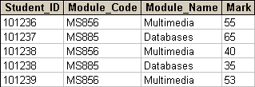
1NF: Anomalies
Primary Key = Student_ID + Module_Code
Insertion Anomaly: cannot create new Module unless a Student has registered to take an exam in that Module
Deletion Anomaly: If there were a Module for which only 1 student was registered, and if we were to delete that record, we would inadvertently delete details of the Module
Update Anomaly: what if the Module_Name corresponding to an Module_Code were to change ? Many records might be affected; all would have to be altered (duplication / redundancy)

Slide 22
Second Normal Form (2NF)
The next step of data analysis is to transform relations into 2NF …
  “Relations” (i.e. tables) must already satisfy rules of 1NF
  2NF looks for an anomaly called a partial dependency, meaning an attribute(s) whose value is determined by only part of the primary key
  all non-key attributes must be fully functionally dependent on the primary key
  Relations that have a single-column primary key are already in 2NF
  Only those relations that have a composite (concatenated) primary key need to be checked
Notes:
No additional notes provided.
414

Slide 23
Second Normal Form (2NF)
To transform a “relation” from 1NF to 2NF, …
  identify all functional dependencies in 1NF
  Make each determinant the primary key of a new “relation” i.e. table
  Place all attributes that are functionally dependent on a given determinant alongside that determinant as non-key attributes in the newly-created relation of which that determinant is the primary key
  ????Confused???? … see worked examples to follow ...

Slide 24
2NF: Example
The above table is in 1NF. What are the functional dependencies ?
  Student_ID + Module_Code → Mark
  Module_Code → Module_Name
In 2NF, we therefore have two further tables:
  EXAM_RESULT = Student_ID + Module_Code + Mark
  MODULE = Module_Code + Module_Name

Slide 25
Third Normal Form (3NF)
Entities are assumed to be in 2NF before beginning 3NF analysis.
3NF analysis looks for two types of problems, derived data and transitive dependencies.
  In both cases, the fundamental error is that non-key attributes are dependent on other non-key attributes
  Derived attributes are those whose values can either be calculated from other attributes, or derived through logic from the values of other attributes
  A transitive dependency exists when a non-key attribute is dependent on another non-key attribute (other than by derivation)
Notes:
If you think about it, storing a derived attribute makes little sense. First, it wastes disk storage space. Second, it complicates simple updates. Why? Every time you change the base attributes, you must remember to re-perform the calculation and also change its result.
414-415

Slide 26
3NF: Example
Consider the following scenario:
  The Health & Safety Officer of an organisation of 300 employees is scheduling an obligatory 1-day Seminar in Ergonomics. The only available venue is capable of holding 50 employees, hence 6 different sessions are necessary. An employee will only have to attend one of these sessions.
  The H & S Officer has created a simple database to help her make arrangements. It contains a SEMINAR table with attributes Employee_ID + Session_Num + Date + Time + Venue
  What is wrong with this structure ?
  … it gives rise to insertion, update, and delete anomalies in much the same way as 1NF

Slide 27
3NF: Example
  … continued:
    SEMINAR = Employee_ID + Session_Num + Date + Time + Venue
  Insertion Anomaly: details of a session cannot be recorded until at least one employee is assigned to that session
  Deletion Anomaly: if there were only a single employee assigned so far to a session, and if that record were to be deleted (say, if the employee left the company), then data pertaining to the session would be inadvertently lost
  Update Anomaly: if 20 employees were assigned to a session, and if that session needed to be rescheduled, all 20 records would have to be updated, else integrity would be breached
  Problem arises because of transitive dependency:
    Employee_ID → Session_Num → Date, Time, Venue

Slide 28
3NF: Example
  … continued:
    SEMINAR = Employee_ID + Session_Num + Date + Time + Venue
  Resolution: split SEMINAR into two relations …
    SESSION = Session_Num + Date + Time + Venue;
    EMP_ASSIGNMENT = Employee_ID + Session_Num
    (Note: In SESSION table, combination of Date + Time + Venue is unique i.e. no double-bookings. But Session_Num is chosen as primary key in preference to this combination because of the principle of minimality i.e. least number of columns)

Slide 29
Third Normal Form (3NF)
“ An entity is in third normal form if every non-key attribute is dependent on the primary key, the whole primary key, and nothing but the primary key”
Notes:
416

Slide 30
Example: Invoice
SALES INVOICE
Cust.No.: D1025
Cust.Name: Knockdown Construction Ltd
Address: Brandon Heights, Annascaul, Co. Kerry
Invoice No.: 654912
Date: Oct 29, 2008
Item Description Qty Unit € VAT Rate Total €
AZ102 Gadgets 50 8.50 21% 514.25
PK644 Yokes 40 9.00 13.5% 408.60
CM245 Widgets 80 6.50 13.5% 590.20
CF107 Tools 75 6.00 0% 450.00
TOTAL 1963.05
Notes:
Assumptions:
The price of an item is separately agreed for each invoice at the time of the sale
VAT rates fluctuate over time, and different rates may apply to different products

